Slide 1
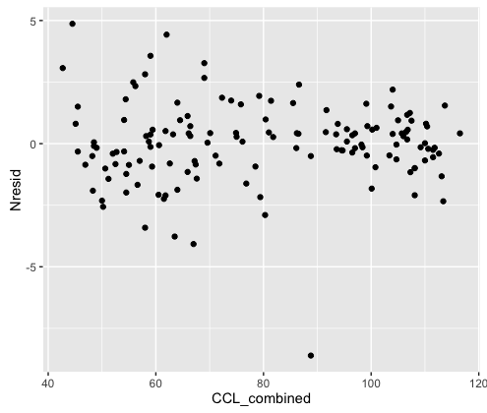
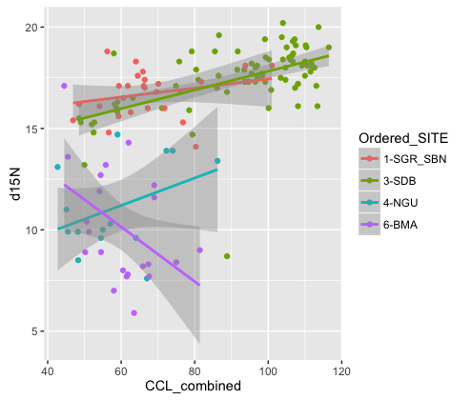
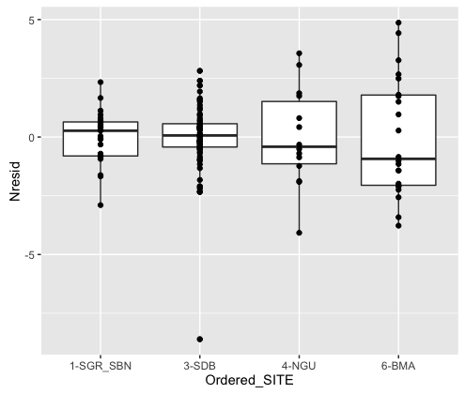
SoCal Baja d15N
Notes:
SoCal Baja d15N
Samples to possibly double check:
#row 558= LABID 919- this is a SDB turtle that has an abnormally low d15N value (as compared to rest of SDB values-looks more like a Baja sample-tell Jeff to double check this just in case tracable lab error etc.)
#row 644=LABID 2187 this is a Magdalena turtle that is the smallest, and has a high d15N value
(see these both on histograms plot)
-N.B. some unequal variance between SoCal and Baja sites (LM assumption); tried some data transformations, actually made it worse. Linear models are robust to modest violations of assumptions, and this doesn’t look that bad…so could just note and move forward. Alternately, could try fitting models with heterogeneous variance structures, but this would take time and don’t want to hold things up.

Slide 2
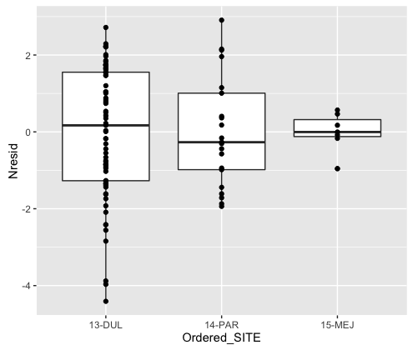
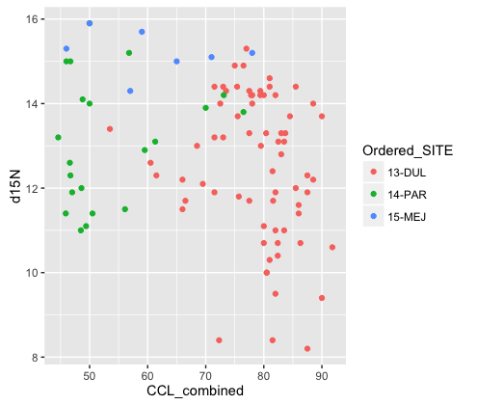
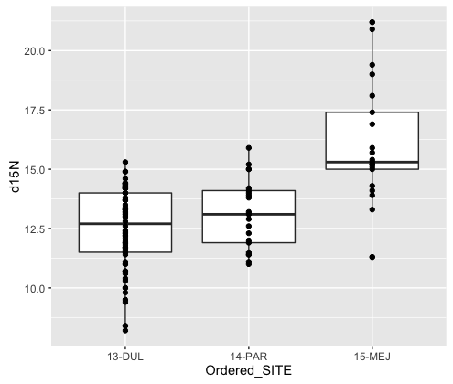
Central-South America Coast d15N
d15N~Site*CCL-notice few Chile samples
d15N~Site-notice Chile samples back
Notes:
Central-South America Coast d15N
Missing turtle size data from Chile results in only 7 cases (vs. 21) able to be used in model-resulting fanning in variance of residuals. Resolves in model with just site (so all 21 samples from Chile can be included)
Prefer to drop CCL from model and do site only?

Slide 3
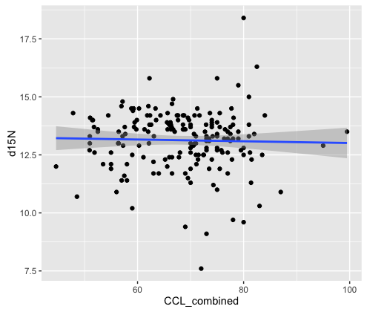
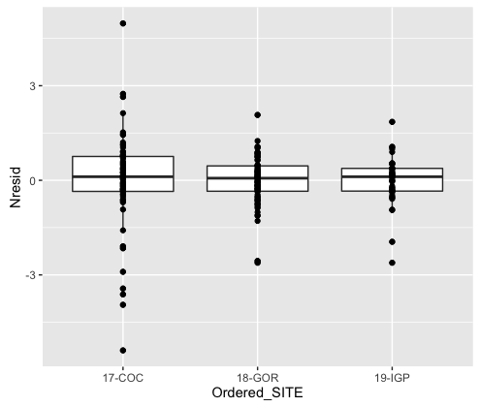
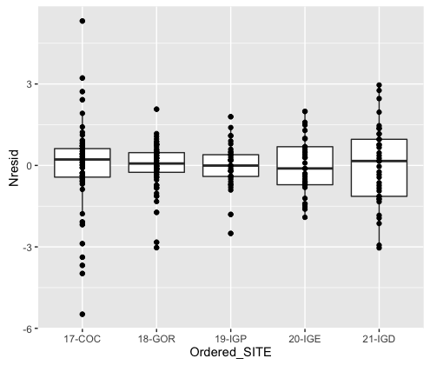
East Pacific Islands d15N
d15N~Site*CCL
d15N~Site
Notes:
East Pacific Islands d15N
-model shows size as a significant covariate but I’ve looked at this a bunch of ways and I don’t see a biological explanation (see graph on right). The only thing possibly is that higher variation of Cocos is driving something? Maybe you see something I don’t.
-N.B., missing CCL data for two locations means that they can’t be included in the analyses if use model with CCL

Slide 4
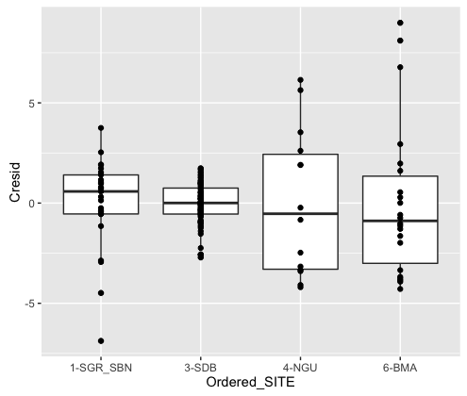
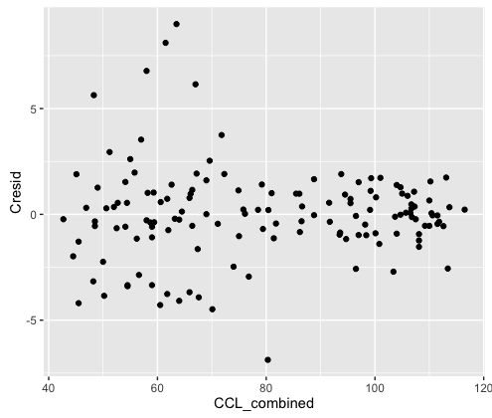
SoCal Baja d13C
Notes:
SoCal Baja d13C
Samples to possibly double check:
#row 695: LABID 158129: strong neg residual-SGR sample-corresponds to lowest (=most negative) carbon value in site (see histogram plot)
#row 661: LABID 2180: strong high residual-Magdalena sample-corresponds to highest carbon at BMA (see histogram plot)
#row 657: LABID 2181: strong high residual-Magdalena sample-corresponds to second highest carbon at BMA (see histogram plot)
-N.B. some unequal variance between SoCal and Baja sites …same as comment under nitrogen

Slide 5
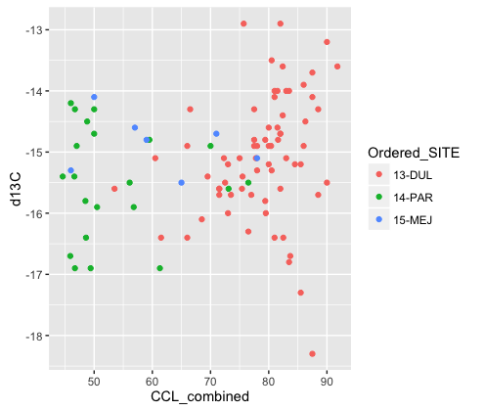
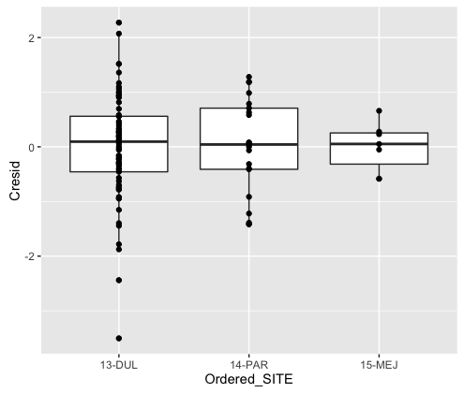
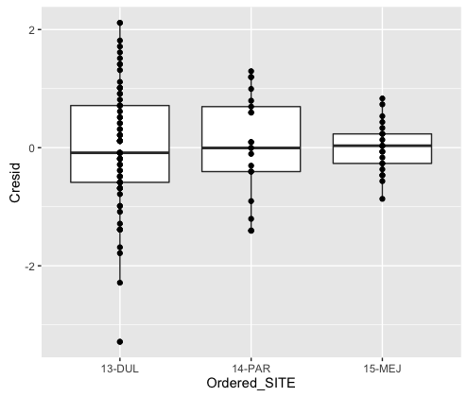
Central-South America Coast d13C
d13C~Site*CCL notice Chile samples dropped
d13C~Site-notice more Chile samples
Notes:
Central-South America Coast d13C
-Fanning in variance of residuals with Chile having lower variance-in contrast to carbon, doesn’t resolve in site only model with all Chile data (see explanation on N slide)
-Two low points for residuals correspond to lowest (most negative values) for C in region, but not that far out (in residuals or raw d13C values-see histograms)

Slide 6
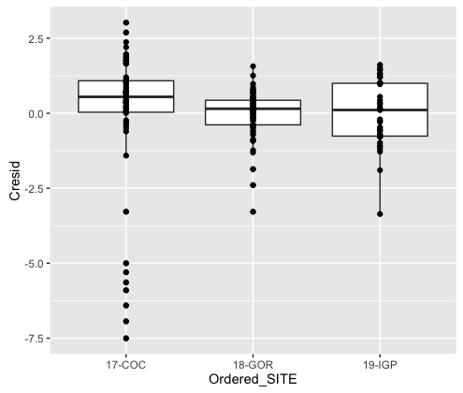
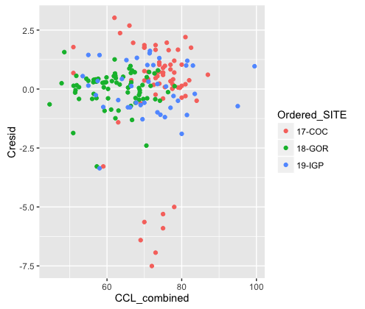
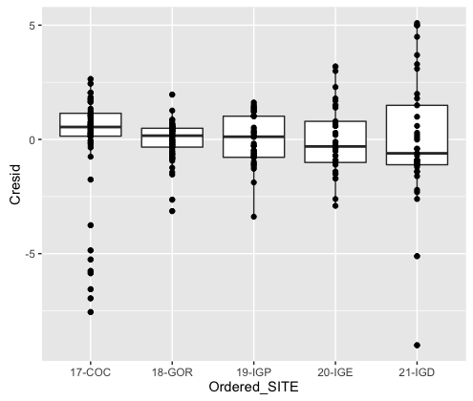
East Pacific Islands d13C
d13C~Site*CCL notice 2 of the galapagos islands samples dropped
d13C~Site
- notice all sites are back-and one turtle at IGD with strong residual is one with most negative d13C value
Notes:
East Pacific Islands d13C
Same issue as N--missing CCL data for two locations means that they can’t be included in the analyses if use model with CCL
Model has harder time with Cocos bc something (interesting) is going on there-see that bottom cluster on the scatterplot

